Slide 1
Challenges in Clinical trial supply chain management
Anh Ninh, College of William and Mary
Notes:
My name is Alex. I am ...

Slide 2
Outline
Introduction
The Inventory Positioning Problem
  Description of the problem
  Unique features
  Basic of inventory management
Site Selection Problem
2

Slide 3
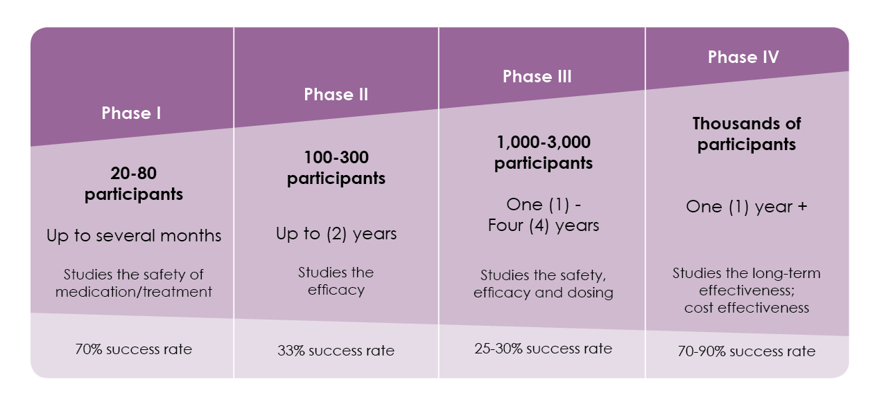
Clinical Trial Stages
Notes:
Phase I: Researchers test a new drug or treatment in a small group of people for the first time to evaluate its safety, determine a safe dosage range, and identify side effects.
Phase II: The drug or treatment is given to a larger group of people to see if it is effective and to further evaluate its safety.
Phase III: The drug or treatment is given to large groups of people to confirm its effectiveness, monitor side effects, compare it to commonly used treatments, and collect information that will allow the drug or treatment to be used safely.
Phase IV: Post Marketing Surveillance Trials, are conducted after a drug or device has been approved for consumer sale. Studies are done after the drug or treatment has been marketed to gather information on the drug's effect in various populations and any side effects associated with long-term use

Slide 4
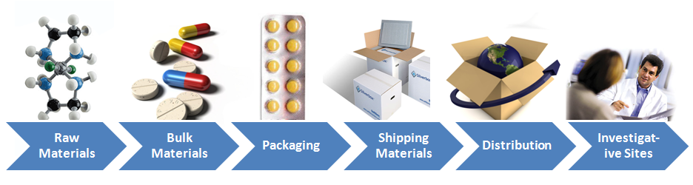
Clinical Trial Supply Chains
“Most current supply chains are entirely inadequate for the realities of global trials today” – Neuer (2008)

Slide 5
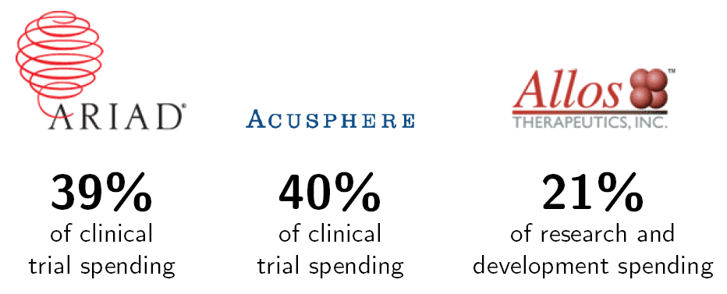
Clinical Supply Chain Spending
Clinical trial supply chains are costly
  Clinical trials account for 37% of $100B in R&D
  Clinical trial supply chains can potentially be 40% of clinical trial spending
  They can potentially be 15% of R&D spending
5

Slide 6
Time Is Critical
Typical patent life: 20 years
Typical drug development cycle: 10-15 years (6-7 years in Clinical Trials)
Slow patient recruitment is one of the key bottlenecks in clinical trials
  80% of clinical trials failed to meet recruitment deadlines*
*Getz & de Bruin (2000)
6

Slide 7
Clinical Trials Are Going Global
Country | Annual Growth Rate of Clinical Trial Sites
China | 47 %
Russia | 33 %
Argentina | 27 %
Czech Republic | 24 %
Mexico | 22 %
United States | -7 %
Source: Thiers, Sinskey, Berndt (2008)
7

Slide 8

Supply Chain Has To Work Harder
Trial Requirements:
612 Patients
99% Service Level
One-Site Trial
612
45-Site Trial
1,035
423 Unused Kits
(planned overage)
8

Slide 9
Overage Is The Norm
“Four years ago, it was the norm … to have an overage of over 100%, sometimes 200%....
…mathematical modeling shows that you can
reduce that overage to under 50%...
… resulting in $120 million of drug substance savings.”
- Source: Patrick Vallone, GSK, 2011
9

Slide 10

Inventory management
How to manage inventory efficiently to support global clinical trials?
What are the key drivers for clinical trial supply chain performance?
10

Slide 11
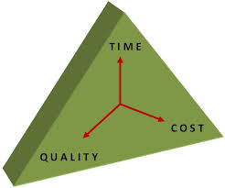
Performance Metrics
Time to recruit the target number of subjects
Inventory/overage of medical kits
Number of subjects rejected
Shipping costs
Inventory cost
Service levels
Rejected subjects
11
Notes:
The clinical trials are measured by three performance metrics: Time, Cost, Quality in terms of Service Level

Slide 12
Outline
Introduction
The Inventory Positioning Problem
    Description of the problem
    Unique features
    Basic of inventory management
Site Selection Problem
12

Slide 13
An Example
An antibiotic: 9-month recruitment period
600 patients, production/warehouse in Italy
Country | Importation Time (days) | # of sites | Enrollment Rate Per Site (patients/day)
Latvia | 3 | 4 | 0.02, 0.04, 0.05, 0.08
Russia | 20 | 4 | 0.03, 0.06, 0.06, 0.28
Ukraine | 15 | 4 | 0.02, 0.04, 0.05, 0.06
U.S. | 10 | 12 | 0.03, 0.04, 0.05, 0.06, 2x0.08, 2x0.11, 2x0.14, 0.16, 0.18
Poland | 8 | 8 | 0.01, 0.02, 3x0.04, 0.06
13

Slide 14
An Example
Drug cost: $4,000/pkg ~ $4 million drug cost
Maximum shipping quantity = 40 pkgs
Shipping time from depot to sites: 1 day
Fixed and variable shipping costs:
  Latvia: $10,000 + $200/pkg
  Russia: $40,000 + $500/pkg
  Ukraine: $15,000 + $750/pkg
  U.S.: $15,000 + $500/pkg
  Poland: $10,000 + $400/pkg
14
Notes:
Estimated drug cost = 4000 * 1000 = $4 million
Maximum shipping quantity = 20 pkg

Slide 15
Analogy – Auto Parts Supply Chains
Central warehouse
Material flow structure
Random and infrequent demand occurring only at the lowest echelon
High service levels
Long lead times
Fixed + variable shipping costs
Depots
Sites
Suppliers
Distribution
Centers
Depots
Dealers
Repair Shops
Notes:
Well studied in the operations management literature

Slide 16
Multi-echelon Literature
One-for-one ordering policies
  Sherbrooke (1968), Graves (1985), Svoronos and Zipkin (1968), Simchi-Levi and Zhao (2005)
Batch ordering policies
  Zipkin (1986), Axsater (1993)
  Caglar, Li and Simchi-Levi (2004), Caggiano, Jackson, Muckstadt, and Rappold (2007)
Reviews
  Zipkin (2000), Muckstadt (2005), Simchi-Levi and Zhao (2011)
16
Notes:
Auto-part SCs have been well studied in the multi-echelon inventory literature. Many papers studied one-for-one ordering policies, and many others studied batch-ordering policies. For a complete review, we refer to the work of Zipkin, Muckstadt and Simchi-Levi and Zhao.

Slide 17
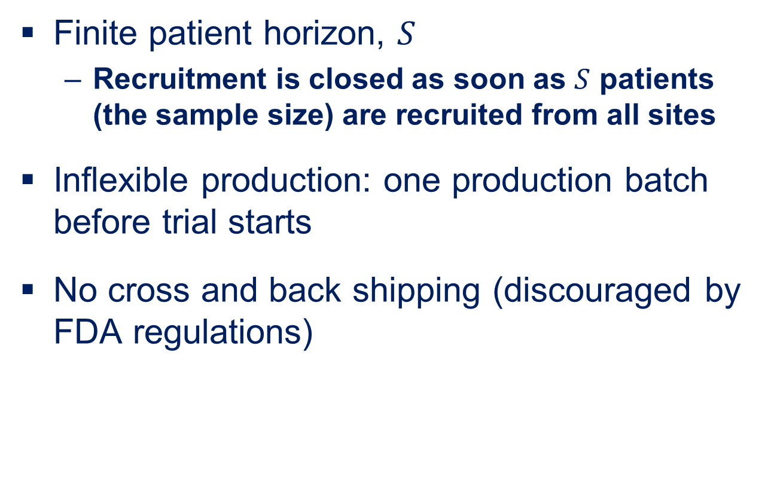
Uniqueness of Clinical Trial Supply Chains I
Finite patient horizon, $S$
  Recruitment is closed as soon as $S$ patients (the sample size) are recruited from all sites
Inflexible production: one production batch before trial starts
No cross and back shipping (discouraged by FDA regulations)
17
Notes:
Talk about disadvantage as well, for example, patient fill rate, should mention that someone might have to wait. Immediate fill rate, someone might not have enough supply.

Slide 18
Uniqueness of Clinical Trial Supply Chains II
Two fill rates (service levels)
  Immediate fill rate at sites: % of patients for whom the investigative drug is available upon arrival
  Patient fill rate for the trial: % of patients entering the trial who are eventually administered the drug
    Patients can be rejected if the site and its supplying depot and central warehouse all run out of stock
18
Notes:
Talk about disadvantage as well, for example, patient fill rate, should mention that someone might have to wait. Immediate fill rate, someone might not have enough supply.

Slide 19
Inventory Strategy – Push
Push all medical packages to sites
High availability at sites, but
  Some sites may stock out
  Others have excessive inventory
Delay the trial and waste inventory
Sites

Slide 20
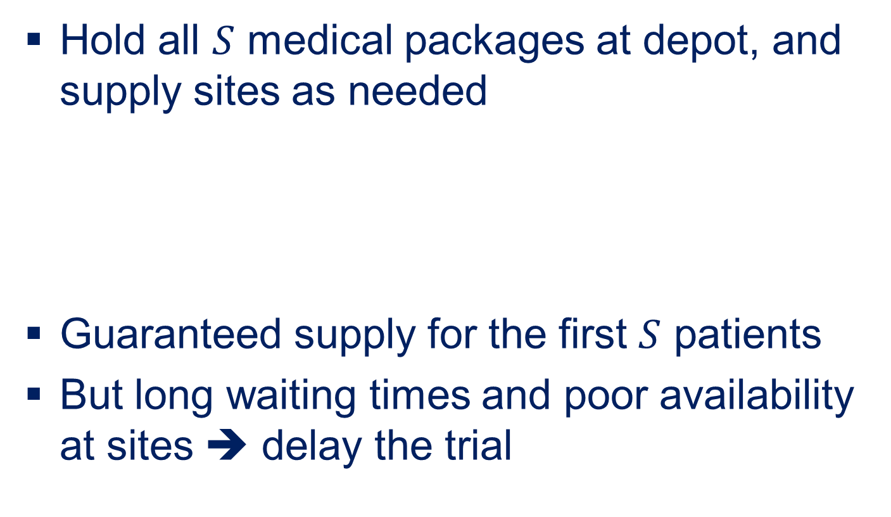
Inventory Strategy – Pull
Hold all $S$ medical packages at depot, and supply sites as needed
Guaranteed supply for the first $S$ patients
But long waiting times and poor availability at sites ➔ delay the trial
Depot
Sites
Notes:
Now, let’s take a look at the pull strategy. High patient fill rate but low immediate fill rates

Slide 21
Inventory Strategy – Balanced
Allocate some medical packages to sites
Hold the rest in a depot
Resupply sites as needed
Depot
Sites
21

Slide 22
The Inventory Positioning Problem
Position inventory at the central warehouse, country depots, and sites
Minimize total inventory and shipping cost
Meet the two fill rate constraints
Central warehouse
Italy
U.S.
Russia
Depots
Sites
22
Notes:
The goal of the inventory positioning problem in clinical trial is to find a smart way to allocate inventory in each of the location in the network (warehouse, depots, and sites) to minimize total supply cost (including inventory and shipping cost)

Slide 23
Driving Forces
Forces pushing inventory to sites
  High immediate fill rates at sites
  High fixed shipping cost
Forces pulling inventory back
  Pooling inventory reduces overage
  High variable shipping cost
Central warehouse
Italy
Depots
U.S.
Russia
Sites
23

Slide 24
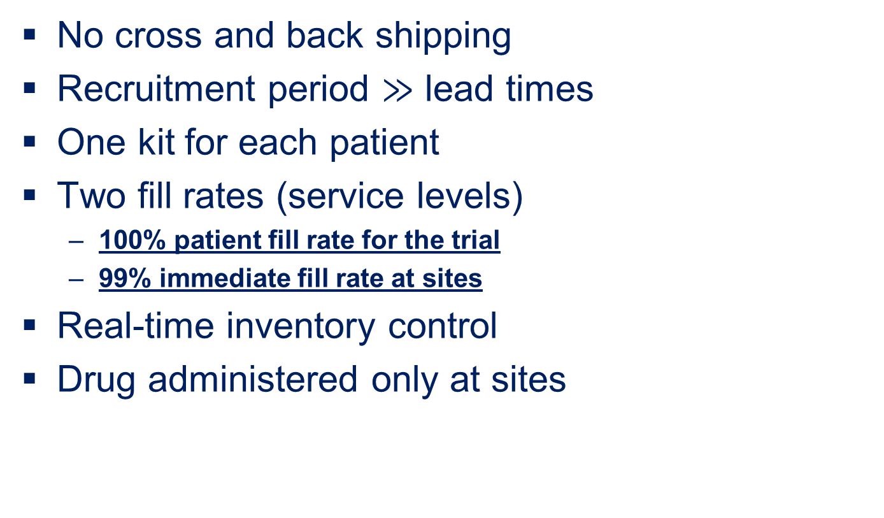
Modeling – Considerations
No cross and back shipping
Recruitment period $≫$ lead times
One kit for each patient
Two fill rates (service levels)
  100% patient fill rate for the trial
  99% immediate fill rate at sites
Real-time inventory control
Drug administered only at sites
24

Slide 25

The Model – In Summary
Minimize: [Inventory Overage + Shipping Costs]
Decisions: inventory positions, shipping quantities
Subject to: High immediate fill rate at all sites
Guaranteed supply for the first $S$ patients
Central warehouse
Italy
Depots
U.S.
Russia
Sites
25
Notes:
The decision variables are inventory positions and shipping quantities in the network.

Slide 26
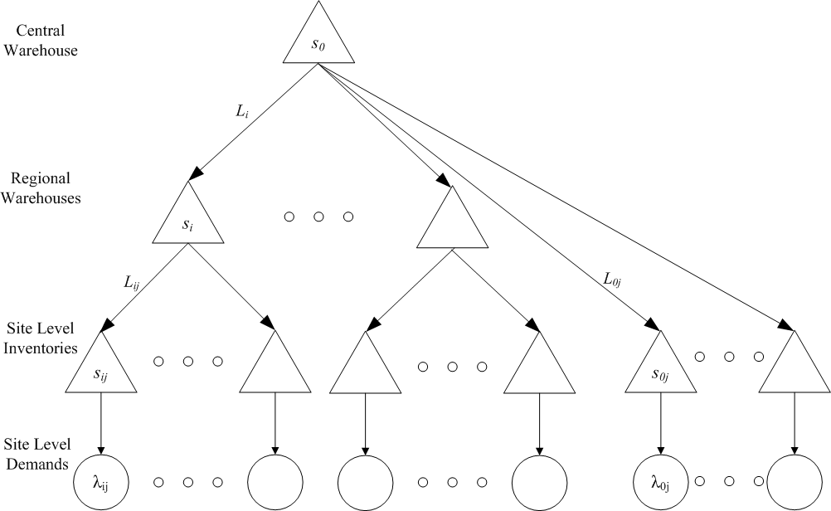

Notable Model Definitions
Country depots
26
Notes:
Here are some notations we use in our model.

Slide 27

Notable Model Definitions
Country depots
27

Slide 28
Notable Model Definitions
Country depots
28
Notes:
This is one of the most notable difference between spare parts chains and a clinical trial supply chain. A clinical trial supply chain is temporary. After the required number of patients are enrolled, the trial is ended.

Slide 29
Drivers for Total Cost
The number of countries and sites in a clinical impacts
  Total operating costs
  Inventory positioning
  Inventory overage
29

Slide 30
Outline
Introduction
The Inventory Positioning Problem
  Description of the problem
  Unique features
  Basic of inventory management
Site Selection Problem
30

Slide 31

Site selection problem
A set of potential countries and sites
Patient costs, trial costs and supply chain costs
What is the most cost effective combination for the clinical trial?
31

Slide 32
Site selection problem
11% of sites in a given trial will not enroll a single patient
Initiating a site costs anywhere from $20,000 to $30,000
There is the cost of maintaining sites, which is estimated to be about $1,500 per month.
http://www.clinicalleader.com/doc/bring-down-the-cost-of-clinical-trials-with-improved-site-selection-0001
32

Slide 33
Site selection problem
Find sites that have a demonstrated track record of good performance in certain trials
Access to patients, higher performance in similar trials in that particular disease area, and credentials of site personnel will all be key components in the site selection process
→ automate this process?
http://www.clinicalleader.com/doc/bring-down-the-cost-of-clinical-trials-with-improved-site-selection-0001
33

Slide 34
Site selection problem
There is a large amount of publicly available data
  Clinicaltrial.gov
Goal: to predict future enrollment in clinical trials using statistical learning
  Performance of sites
  Geodemographic patients (patients have convenient access to the study site, and that patient populations are close in proximity to the study site)
https://www.linkedin.com/pulse/20140324171436-55450526-break-from-the-herd-analytically-optimizing-study-site-selection
34

Slide 35
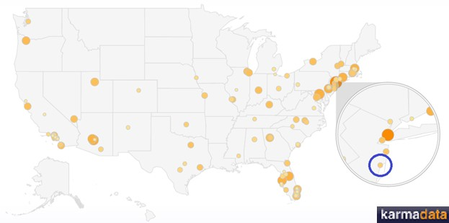
Site selection problem
Aggregated data for all actively recruiting Alzheimer’s clinical trials in the US
https://www.linkedin.com/pulse/20140324171436-55450526-break-from-the-herd-analytically-optimizing-study-site-selection
35

Slide 36
Site selection problem
There are 38 Alzheimer’s clinical trials in New York City.
Due to study crowding in the NYC region, we looked at sites in the Tom’s River and New Jersey areas, where there are less clinical trials, and we found several healthcare research centers with solid capabilities and sufficient physician research
https://www.linkedin.com/pulse/20140324171436-55450526-break-from-the-herd-analytically-optimizing-study-site-selection
36

Slide 37
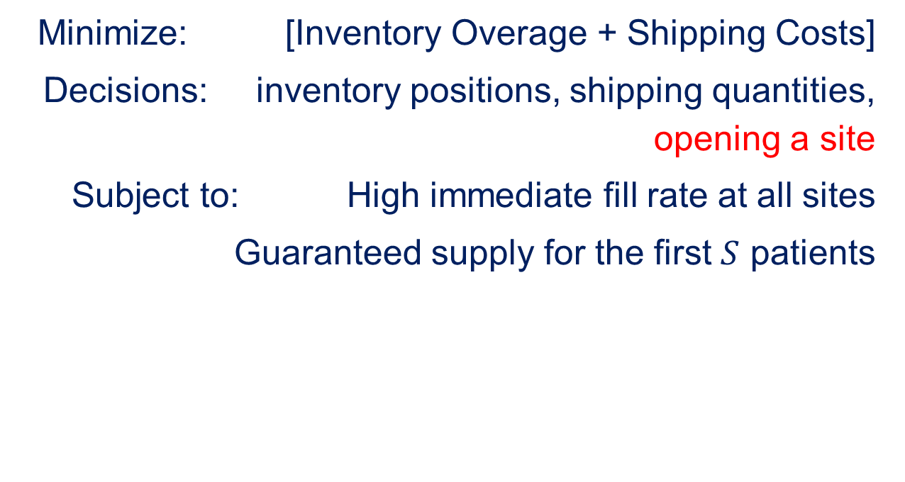
The Model – In Summary
Minimize: [Inventory Overage + Shipping Costs]
Decisions: inventory positions, shipping quantities, opening a site
Subject to: High immediate fill rate at all sites
Guaranteed supply for the first $S$ patients
Central warehouse
Italy
Depots
U.S.
Russia
Sites
37
Notes:
The decision variables are inventory positions and shipping quantities in the network.

Slide 38
Notable Model Definitions
Country depots
38

Slide 39
Recap
Supply chains for clinical trials have unique features and are hard to manage
Mathematical model and optimization can achieve significant savings on supply costs for global trials
  Inventory positioning
  Site selection problem
39

