Slide 1
Reducing Smartphone Application Delay through Read/Write Isolation
David T. Nguyen, Ph.D.
http://davidnguyen.cz

Slide 2
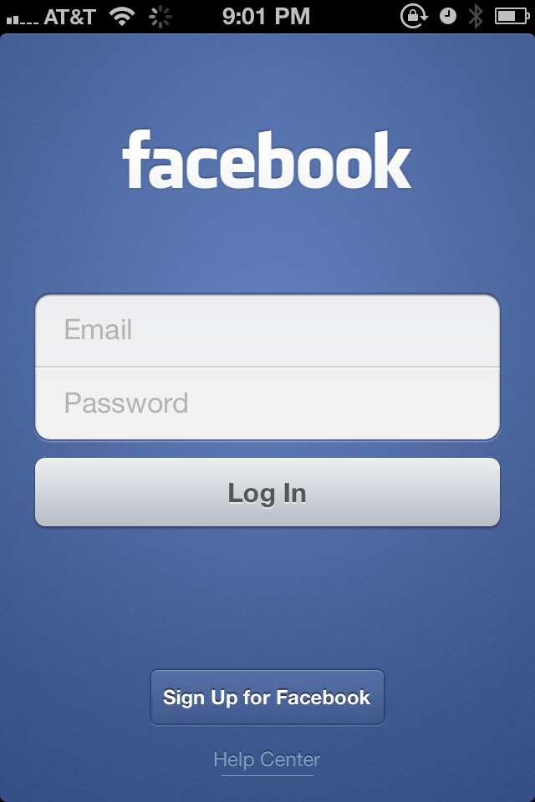
Real-world Problem: Application Delay
Figure Courtesy: Facebook Connectivity Lab

Slide 3
Introduction
Research questions
How does disk I/O affect smartphone application response time?
How to optimize storage to improve application performance?
Contributions
First large-scale Android I/O study on 2611 devices
Proposed SmartIO scheduler that reduces application delay
Evaluation indicates 21% reduced launch and 17% reduced run-time delay

Slide 4
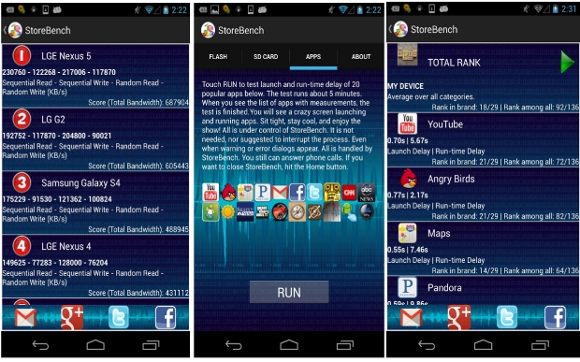
StoreBench Benchmark
www.StoreBench.com

Slide 5
Benchmark Demo
Link: https://youtu.be/_76Af8kLWw0
Flash test from 0:00
Apps test from 3:53
Apps ranking from 8:32

Slide 6
Data Sample
Samsung GT-I9505G; 4.3; 10754; 80908; 2904; 81108; 20131022_231952; 264; 34; 12.7G; 11.1G; 4; 981M; 853M; 16; 0.372; 0.049; 1.377; 0.049; 50; 46; 4; flash; 865be6e77cd6b3d3
Samsung GT-I9505G; 4.3; 10687; 96660; 2898; 90770; 20131027_194034; 272; 38; 12.7G; 10.5G; 4; 981M; 853M; 16; 0.374; 0.041; 1.380; 0.044; 50; 39; 11; sdcard; 865be6e77cd6b3d3
LGE Nexus 4; 4.2.2; 0.67; 6.59; 0.45; 2.07; 0.64; 7.02; 0.46; 1.40; 0.46; 6.49; 0.55; 11.00; 0.50; 3.97; 0.59; 13.77; 0.48; 11.41; 0.61; 4.74; 0.47; 1.62; 0.51; 1.44; 0.83; 4.22; 0.50; 14.84; 0.48; 3.70; 0.56; 4.87; 0.56; 1.71; 0.54; 5.28; 0.59; 3.07; 0.62; 5.36; 20131027_162146; apps; 77bf180fcd17989a

Slide 7
Sending Data from Android App
Complete code
https://github.com/dunguk/StoreBench
String cmd = "/system/bin/ps | wc -l > /data/data/com.dnguyen.storebench/result.txt";
execCmd(cmd);
String result = getShellOutput("/system/bin/cat /data/data/com.dnguyen.storebench/result.txt");
HashMap<String, String> data = new HashMap<String, String>();
data.put("value", result);
AsyncHttpPost asyncHttpPost = new AsyncHttpPost(data);
asyncHttpPost.execute("http://storebench.com/file.php");

Slide 8
Writing Data to Webserver
<?php
$content = $_POST['value'];
$file = "file.txt";
$Saved_File = fopen($file, 'a');
fwrite($Saved_File, "\n" . $content);
fclose($Saved_File);
?>

Slide 9
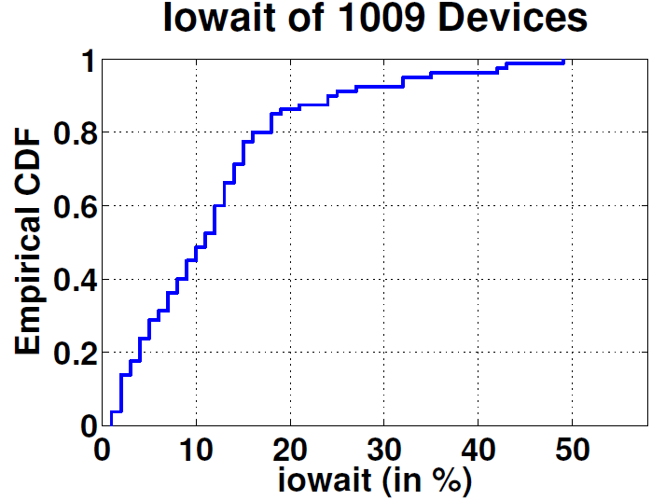
Iowait of 2611 Devices
CPU active time spent waiting for storage I/O
40% devices between 13% and 58%
Significant CPU time spent waiting for storage

Slide 10
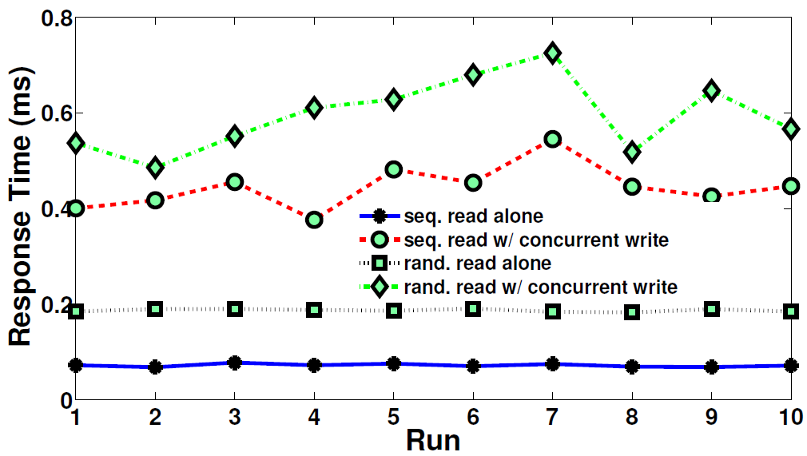
I/O Slowdown
Seq. reads experience up to 626% slowdown when blocked by concurrent writes (rand. up to 293%)
I/O slowdown possible source of worse app launch (reads dominate)

Slide 11
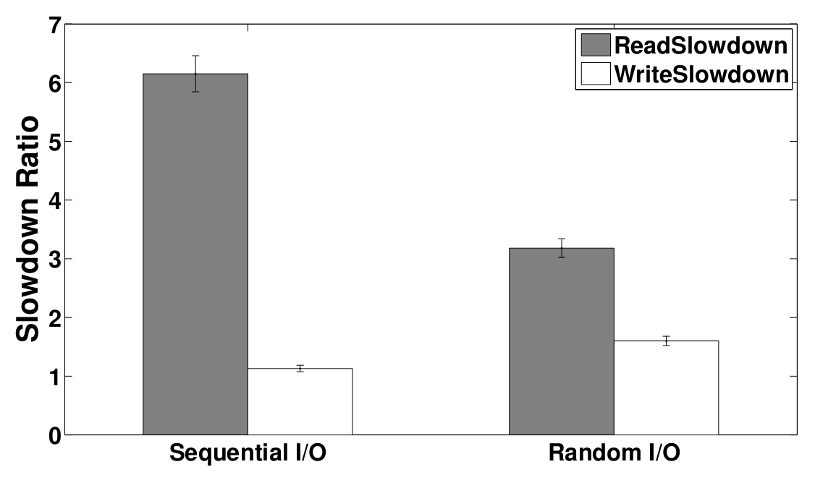
Slowdown Asymmetry
ReadSlowdown = Response time of a read in the presence of a concurrent write / Response time of a read when running alone
WriteSlowdown = Response time of a write in the presence of a concurrent read / Response time of a write when running alone
Read slowdown up to 6.15 vs. write slowdown up to 1.6

Slide 12
Study Summary
Android devices spend up to 58% of CPU active life time idling due to I/O
Reads experience up to 626% slowdown when blocked by concurrent writes
Large slowdown asymmetry (reads up to 6.15; writes up to 1.6)

Slide 13
SmartIO
User Space
Kernel Space
I/O Scheduler
I/O Priority Assignment
Storage
Subsystem
I/O Grouping
Concurrency
Profiler
I/O Dispatch

Slide 14
queue
queue
0 1 2 3 4 5 6 7
0 1 2 3 4 5 6 7
7
Real-time
Best Effort
Idle
Idle
write
Best Effort
read
Real-time
Dispatch
Queue
FLASH BLOCK DEVICE

Slide 15
Notes:
Demo SmartIO

Slide 16
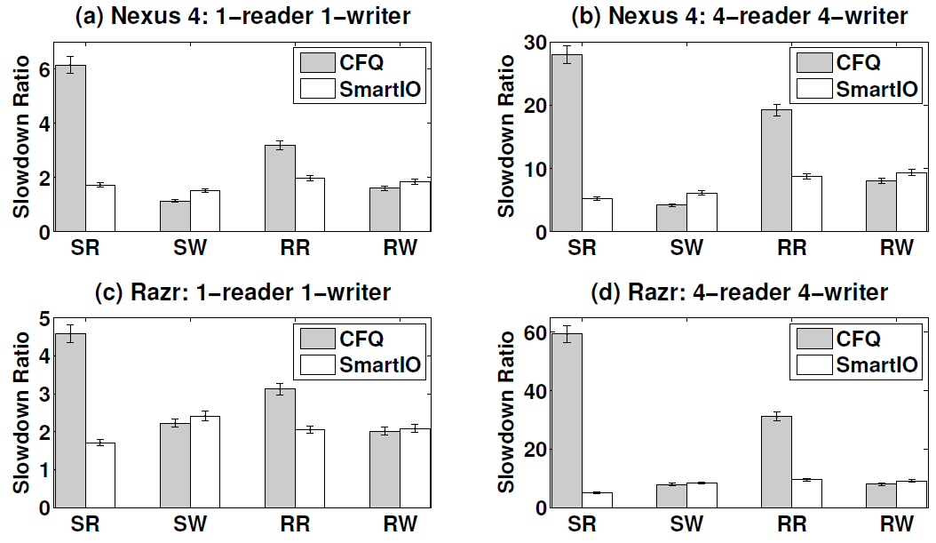
Gain vs. Cost
Nexus 4: 1-reader (128MB), 1-writer (128MB)
Seq. read slowdown improves from 6.15 to1.72 (gain), write worsens from 1.13 to 1.51 (cost)
Rand. read slowdown improves from 3.18 to 1.97 (gain), write worsens from 1.6 to 1.83 (cost)

Slide 17
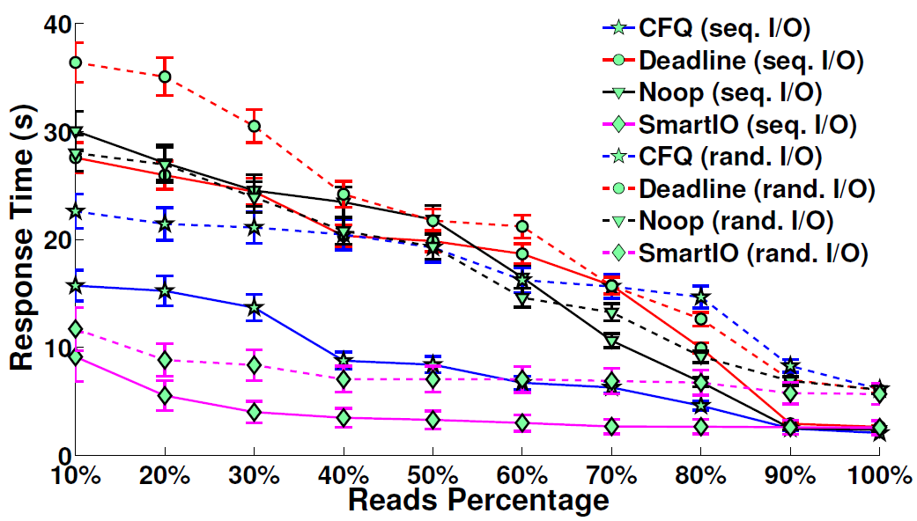
Scheduler Comparison
128MB mixed workload (first 10% reads, then 20%..)
With increasing percentage of reads, response time decreases (less writes means less slowdown)
By changing scheduler (default CFQ to SmartIO) we achieve on average 49% faster response (max. 66%)

Slide 18
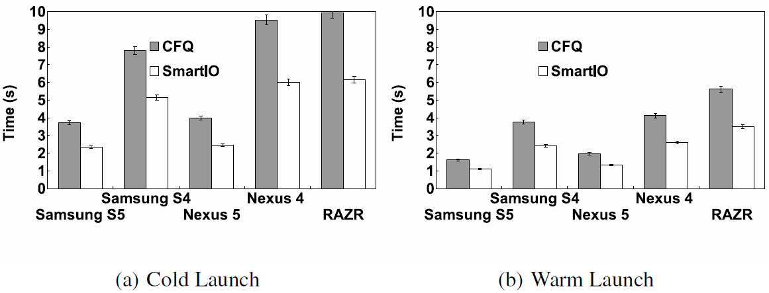
Facebook Performance
Facebook Inc.’s goal:
cold launch < 5s on 2012 or newer devices
cold launch < 10s on older devices
RAZR (2012): 9.9s -> 6.2s
Samsung S5 (2014): 3.7s -> 2.3s

Slide 19
Outcome & Impact
1 U.S. patent
Several papers
VA Governor Research Commercialization Award ($99K)
Papers used for research and teaching by universities and labs (Stanford, CMU, MSR, KAIST, etc.)
Google Play app helped 3,300+ users determine device performance
Interest from industry (Google, Facebook, Qualcomm)

Slide 20
Conclusion & Future Work
SmartIO
Reduces app delays through read/write isolation and higher read priorities
Study other stages of app life cycle (install, update, switch, uninstall)
Analyze impact of network I/O

Slide 21
Acknowledgments
Our shepherd Prof. Mahadev Satyanarayanan (CMU)
Aaron Carroll (NICTA), Dr. Duy Le (EMC), Dr. Tommy Nguyen (RPI), Mai Anh Do (CNU), Dr. Daniel Graham (Microsoft)

Slide 22
Reading (optional)
http://davidnguyen.cz/papers/mobisys15-nguyen.pdf

Slide 23
Facebook Connectivity Lab
Inventing future of connectivity
Link: https://youtu.be/pxX6r-xDgG4
Aquila project
Link: https://goo.gl/YlOeiu

