Slide 1
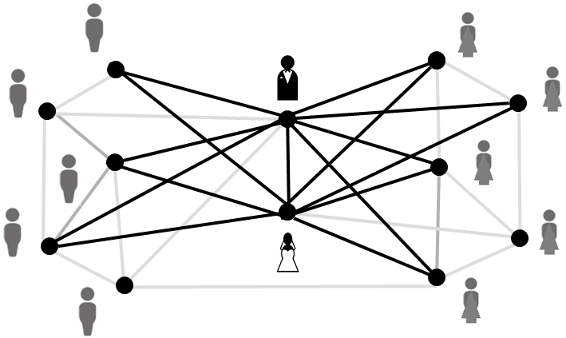
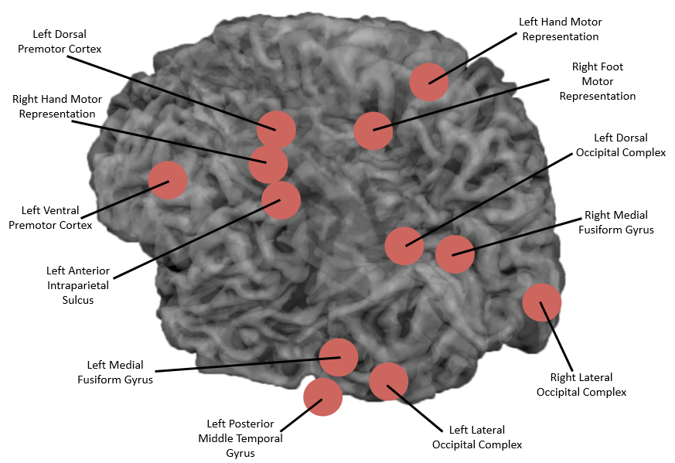
Graph theory methods for analyzing social and neural network data
Darren A. Narayan
Rochester Institute of Technology
Joint work with Roger Vargas, Williams College, Bradford Mahon and Frank Garcea, Rochester Center for Brain Imaging, University of Rochester
Supported by NSF-REU Grant #1358583

Slide 2
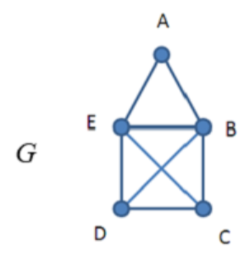
Graph Theory
A graph is comprised of a set of vertices (dots) and edges (lines) where a line joins two vertices.
Graphs can be used to model social, biological, transportation, and other types of networks.

Slide 3
For example we can use a graph to represent relationships among attendees at a wedding.
We note that in this network that everyone knows the bride or the groom (or both).

Slide 4
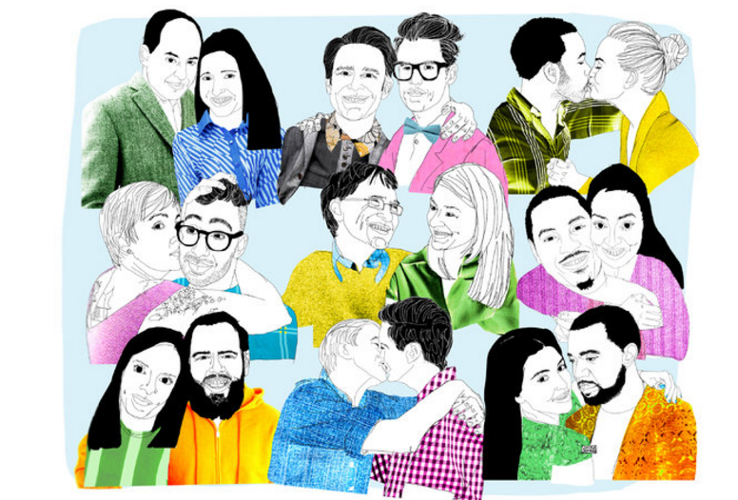

Slide 5
However suppose we want to see who is best connected to both the bride and the groom.

Slide 6
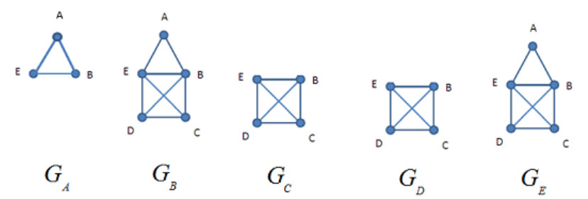
“Local closed neighborhoods”

Slide 7
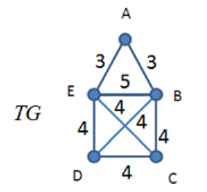
The number of subgraphs in which each edge appears:
“Clustering Centrality”

Slide 8
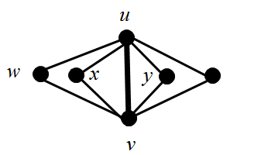
Clustering centrality can be linked to a problem in structural graph theory.
A common problem in structural graph theory is: Given a graph G determine a largest sized particular subgraph H.
In our case H will be a “book graph”.
z
“book graph”

Slide 10
Applications

Slide 11
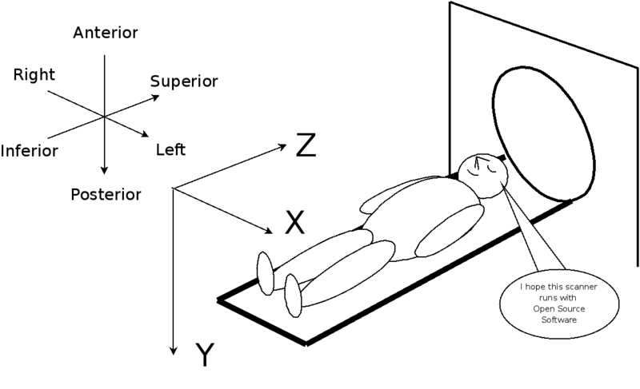
Analysis of functional MRI data

Slide 12
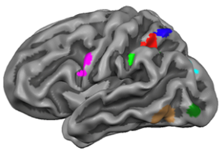
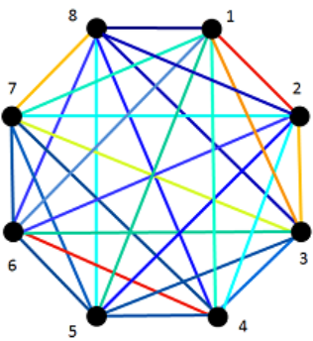
From Brains to Graphs
In our study we will use graph theory to model the brain. The vertices will represent regions of the brain and edges will represent functional connections between the regions.

Slide 13
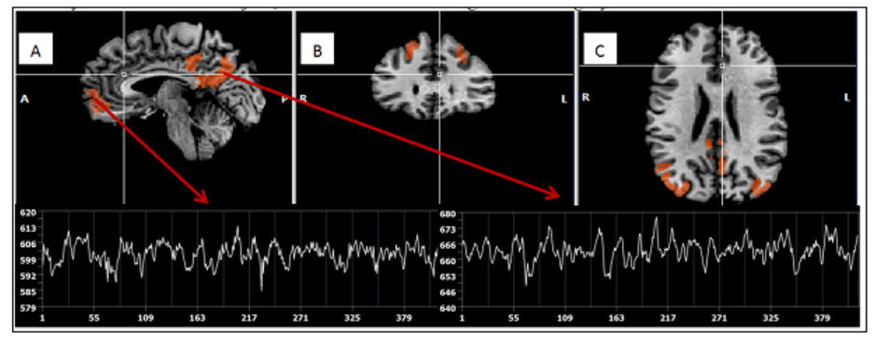
We monitor oxygen levels in the blood over the length of a scan.
Images from E. B. Hintz, URMC

Slide 14
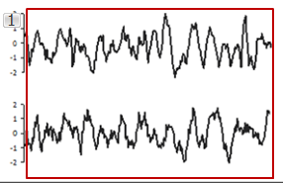
Images from F.E. Garcea, B.Z. Mahon

Slide 15
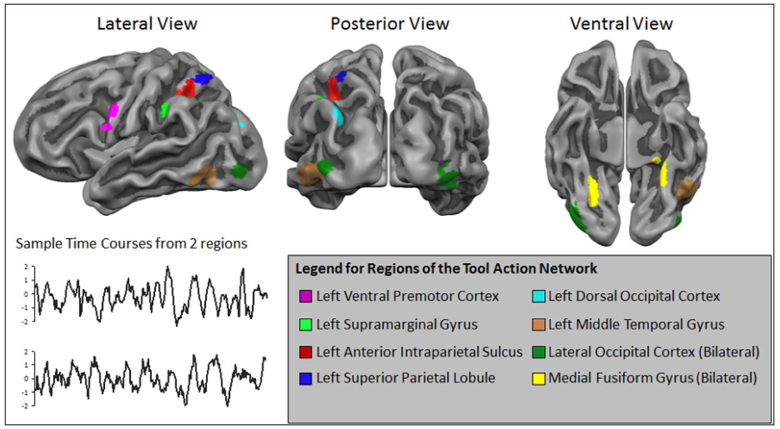
Here we can see the time course data for different regions of the brain.
Images from F.E. Garcea, B.Z. Mahon

Slide 16
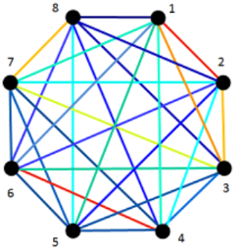
Then we not only analyze a single graph but sequence of several hundred graphs.
…
“Temporal Graph Theory”

Slide 17
We used clustering centrality to analyze networks arising from functional MRI data from the Rochester Center for Brain Imaging.
In the research study 12 subjects were asked to undergo functional MRI scans where they would view and pantomime various tools (hammer, scissors, screwdriver, knife, pliers, corkscrew). (All subjects were right-handed).
We looked at correlations between the blood oxygen levels between each pair of 12 different regions. A two sided t test was performed and statistically significant values (t > 2.75) were selected.
We then created two networks: (i) pantomiming was greater than viewing (ii) viewing greater than pantomiming

Slide 19
Clustering Centrality: Viewing Greater than Pantomiming

Slide 20
Clustering Centrality: Pantomiming Greater than Viewing

Slide 21
Clustering Centrality: Pantomiming Greater than Viewing

Slide 22
Clustering Centrality: Pantomiming Greater than Viewing

Slide 23
When pantomiming > viewing the motor regions show increased correlations.
When viewing > pantomiming the visual regions shown increased correlations.

Slide 24
Future Research
Apply temporal graph theory to determine the duration that a correlation remains elevated after a stimulus is presented and removed.

Slide 25
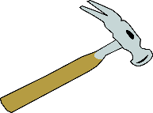
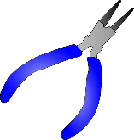
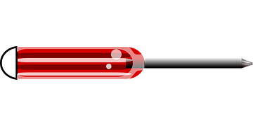
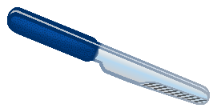
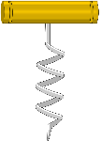
Future Research
Conduct a more in-depth analysis of the tool viewing / pantomiming study *.
Pliers
Screwdriver
Same action, different purpose
Hammer
Knife
Corkscrew
Scissors
* Links with a study by Quanjing Chen and Bradford Mahon, RCBI / UR

Slide 26
Future Research
Conduct a more in-depth analysis of the tool viewing / pantomiming study *.
Pliers
Screwdriver
Same purpose, different action.
Hammer
Knife
Corkscrew
Scissors
* Links with a study by Quanjing Chen and Bradford Mahon, RCBI / UR

Slide 27
Brain connectivity and Traumatic Brain Injuries in Athletes
A study involved 10 football players that received DTI scans before and after the season.

Slide 28
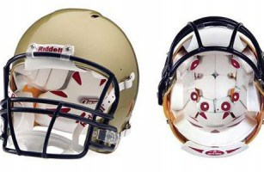
Helmets were outfitted with linear accelerometers with the Head Impact Telemetry System (HITS).
Each impact to the helmet is measured with both linear and rotational acceleration.

Slide 29
Repetitive sub-concussive head hits (RSH) (incurred during sports, military duty, and alike) produce changes in brain white matter (WM) that may contribute to the development or progression of chronic traumatic encephalopathy (CTE) later in life.
Research studies have shown an inconsistent relationship between acute brain WM changes and the total number and magnitude of RSHs over a season of play.
Prior research has not accounted for the interval of time between hits (TBH) or the period of time between an impact and the assessment (e.g. diffusion tensor imaging; DTI) (TUA).
Frequency of exposures or time between RSHs, as well as timing of exposure relative to measuring the outcome (TUA), is likely to influence brain WM changes.

Slide 30
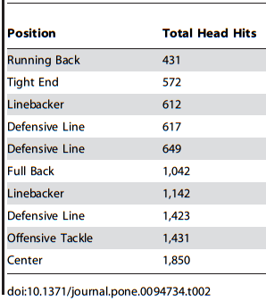
10 collegiate football players at the University of Rochester

Slide 31
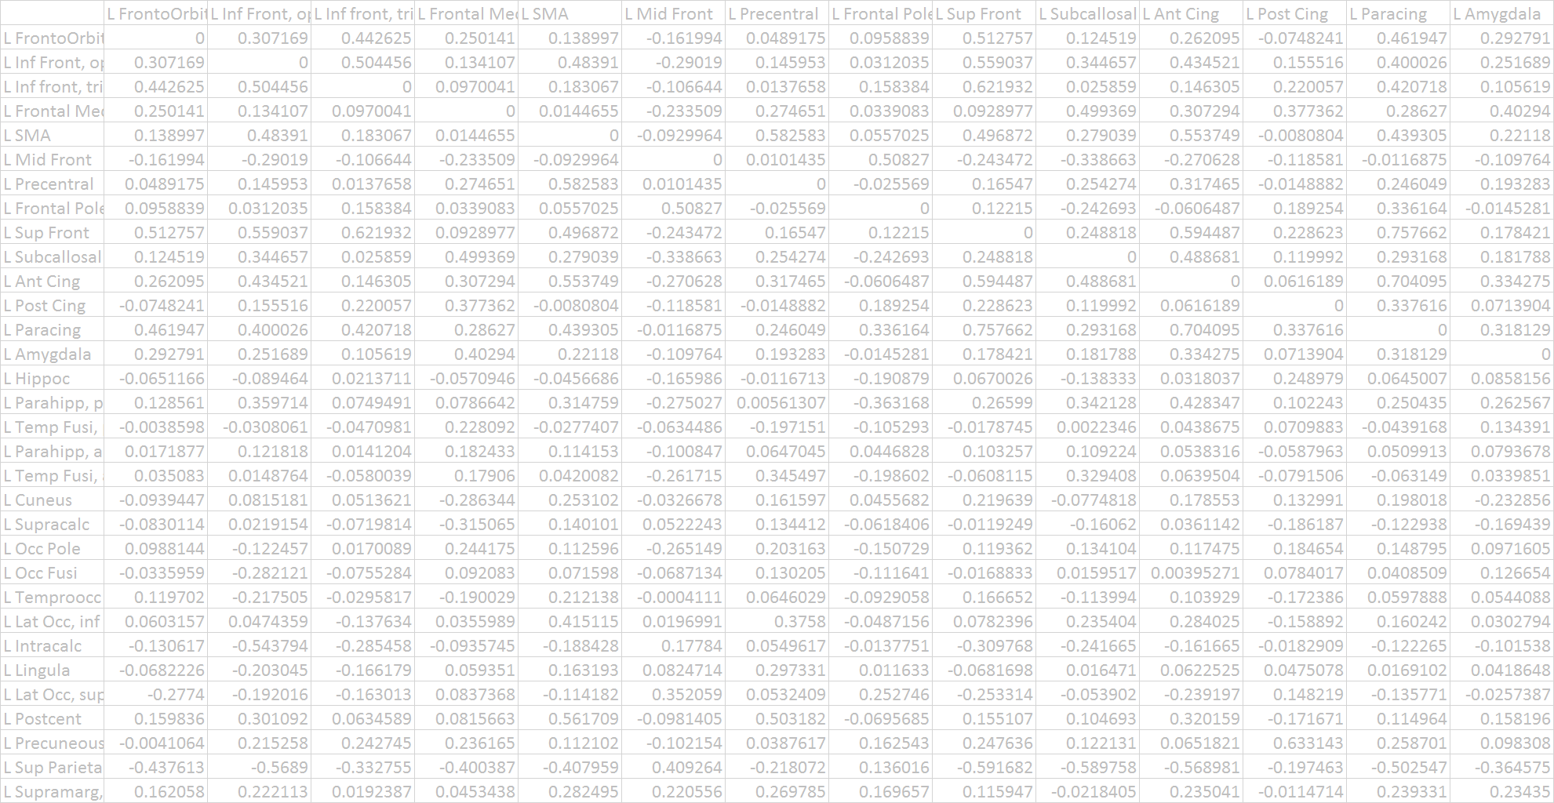
The data from the MRI machines can be large.
(But not necessarily what is called “Big Data”).
Excel file

Slide 32
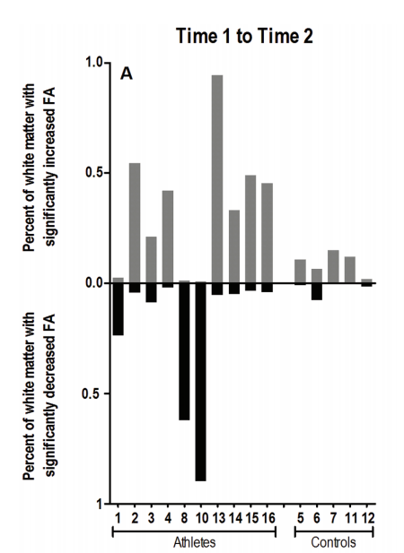

Slide 33
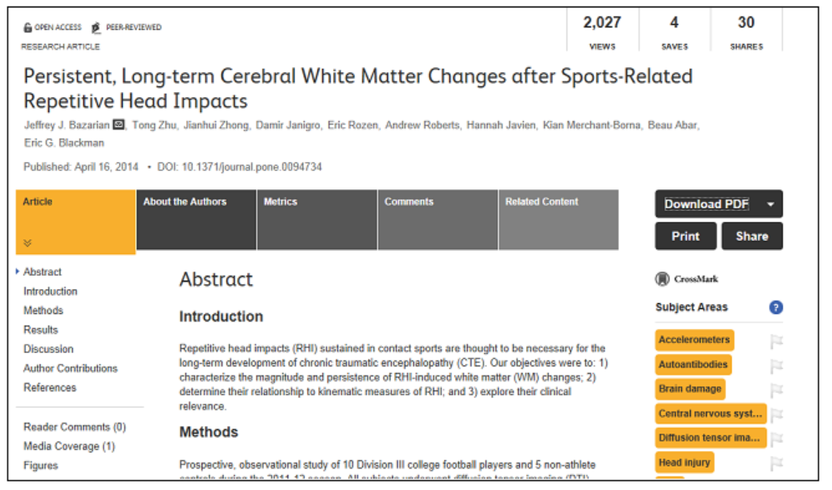
Looked at the percentage of whole-brain WM voxels with significant changes in fractional anisotropy (FA) (FA; a measure of microstructural integrity) before and after the season.

Slide 34
Modeling the cumulative effect of successive hits and time until assessment
We consider a cumulative effect starting with the second hit where an impact of a
hit is magnified by the length of the time interval since the previous hit.
In this model we assume there will be a greater total be an enhanced effect
if multiple hits occur over a short time interval.
For a hit, the weighted value in this model combines the unweighted value
of a hit with all of the previous hits, each of which is weighted by 1 divided
by the time interval between successive hits.
Let n be the total number of hits taken on day d and let
stand for the impact of the n-th hit on day d.
Let T(d) be the total weighted value of impacts over day d.

Slide 35
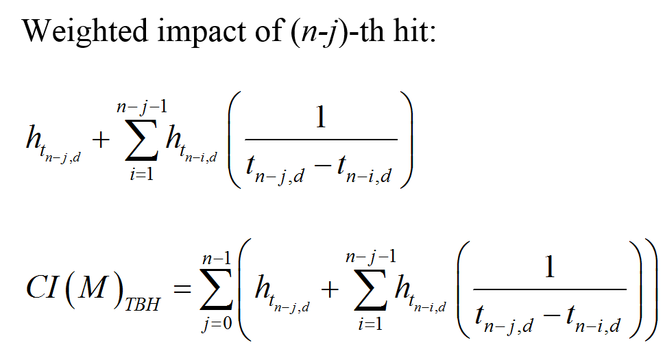
Modeling the cumulative effect of successive hits and time until assessment
We consider a cumulative effect starting with the second hit where an impact of a
hit is magnified by the length of the time interval since the previous hit. In this model we assume there will be a greater total be an enhanced effect
if multiple hits occur over a short time interval.
For a hit, the weighted value in this model combines the unweighted value
of a hit with all of the previous hits, each of which is weighted by 1 divided
by the time interval between successive hits.

Slide 36
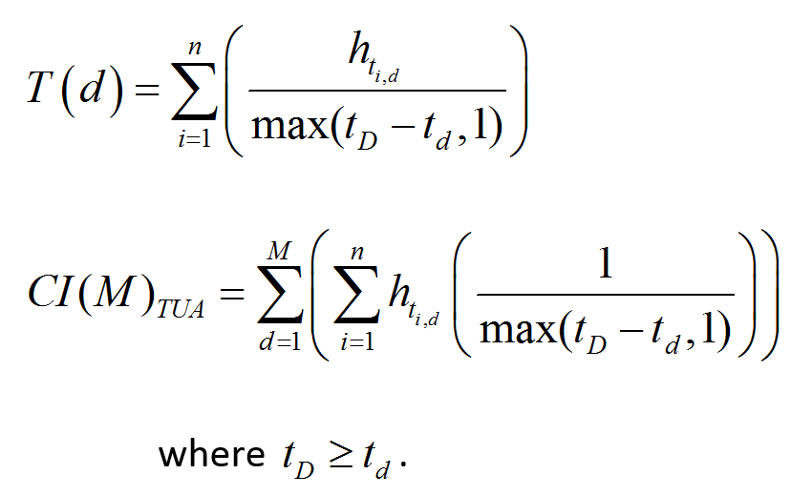

Slide 37
.
The cumulative impact over M days is given by:
where

Slide 38
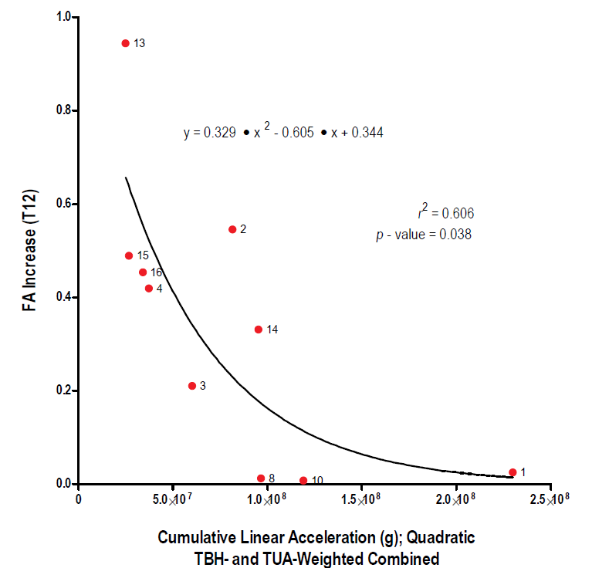
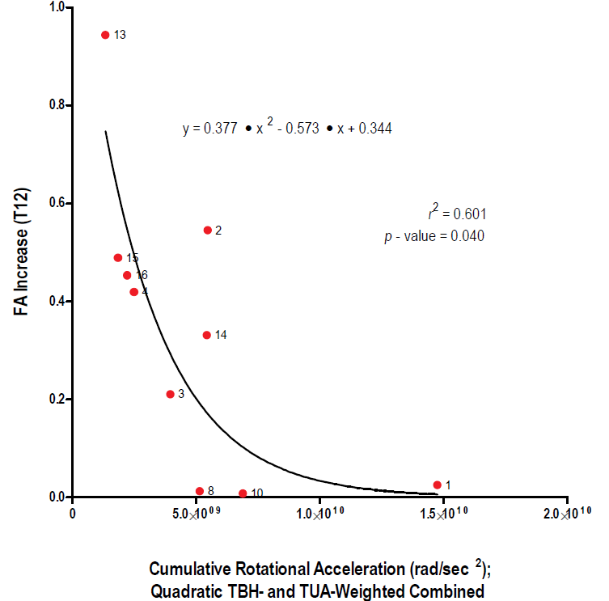

Slide 39
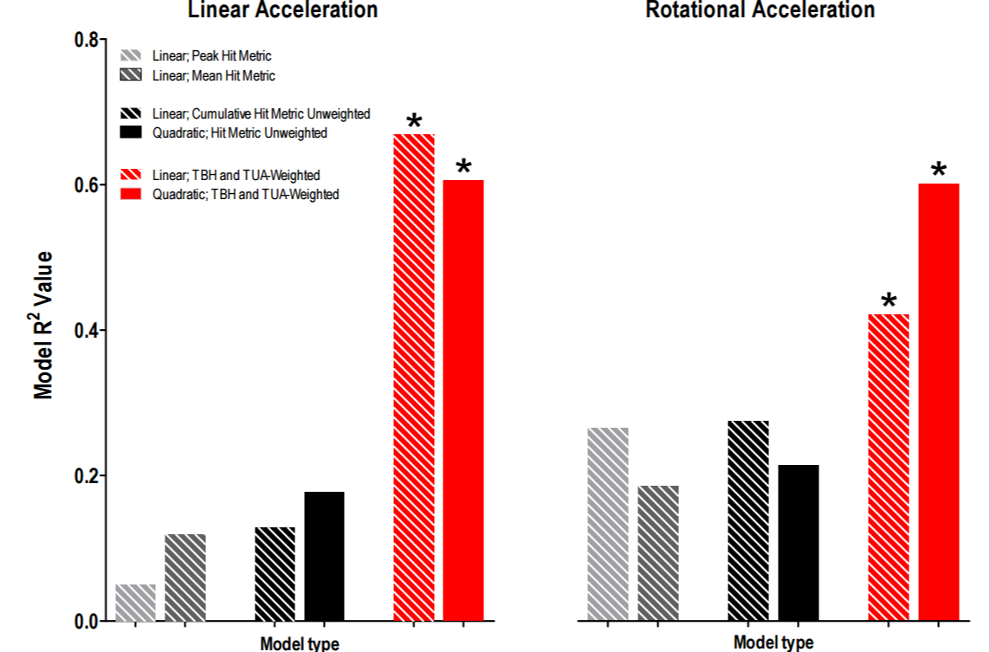
Increased fractional anisotropy (FA) is known to be linked to schizophrenia and ADHD.
(Li et al. 2010)

Slide 40
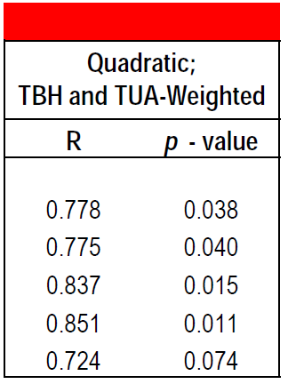
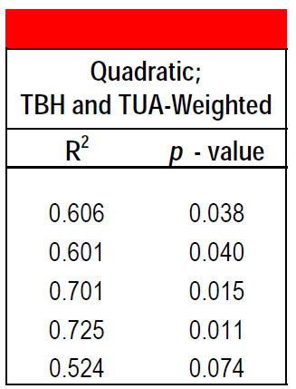
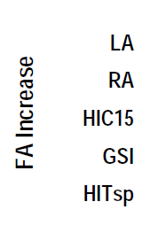
Merchant-Borna, K., Asselin, P, Narayan, D., Abar, B., Jones, C., and Bazarian, J.J., Novel method of weighting cumulative helmet impacts improves correlation with brain white matter changes after one football season of sub-concussive head blows, submitted to the Annals of Biomedical Engineering.

Slide 41
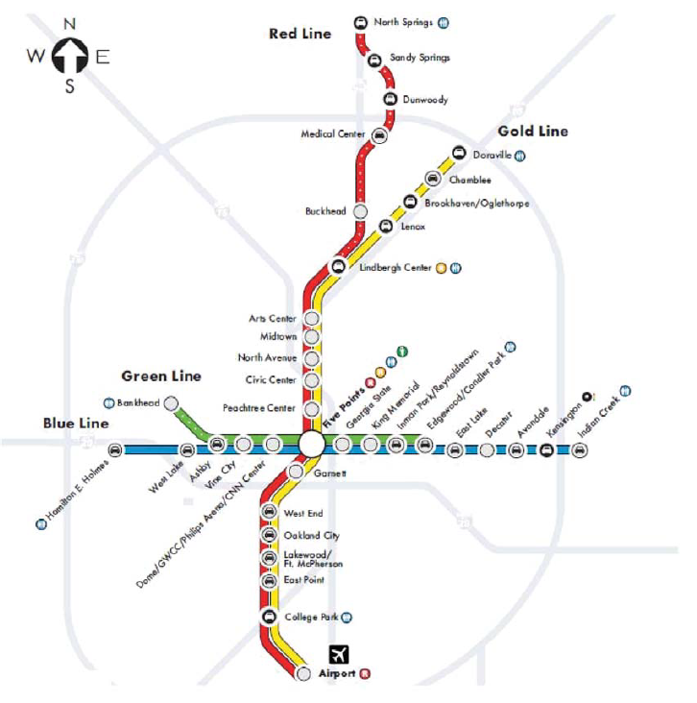
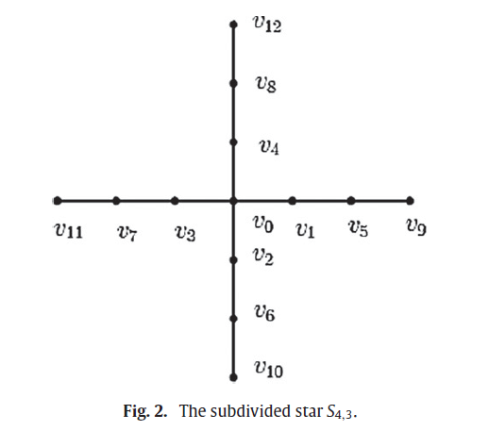
Using graph theory to assess efficiency in transportation network design

Slide 42
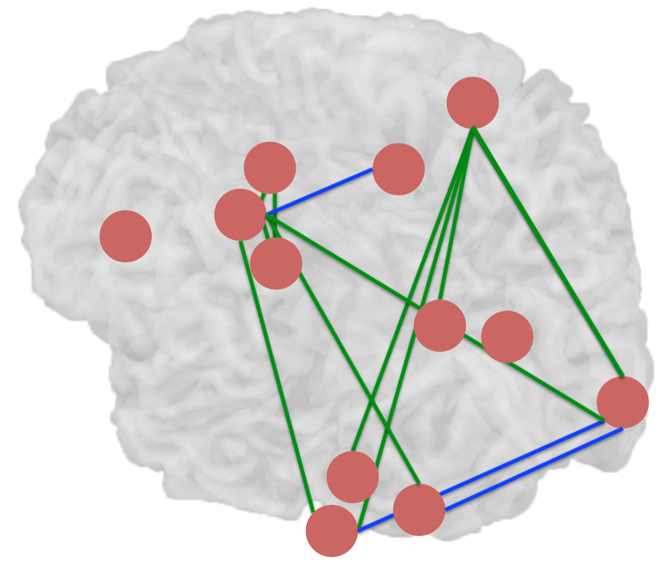

Slide 43
“Euclidean Efficiency”

Slide 44
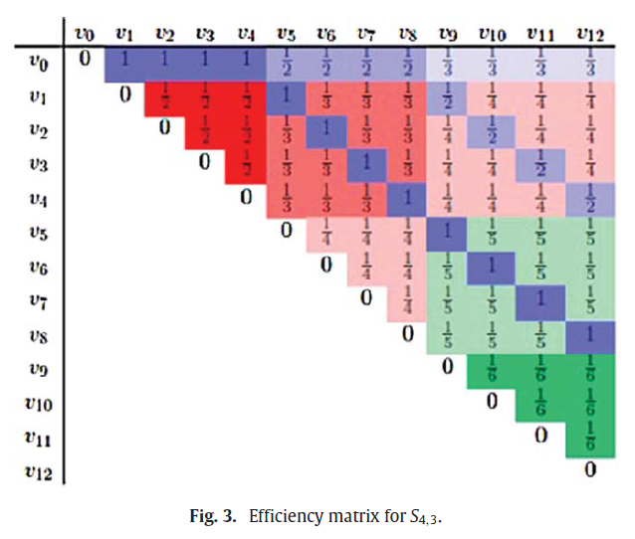

Slide 45
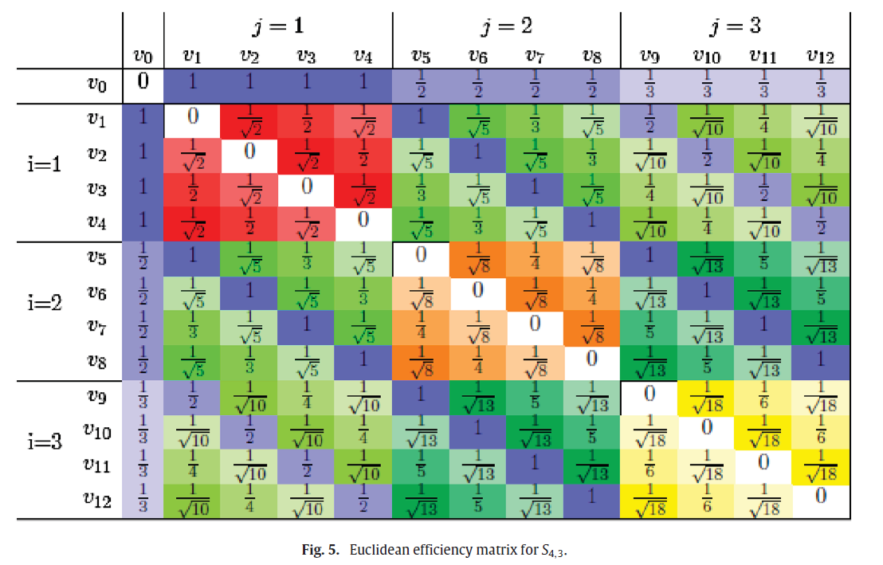
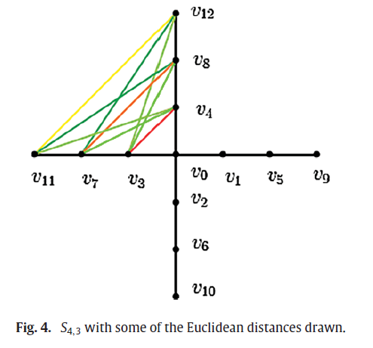

Slide 46
Metropolitan Atlanta Rapid Transit Authority (MARTA)
How efficient is the network compared to a network where every pair of stations is connected by a direct line?

Slide 47
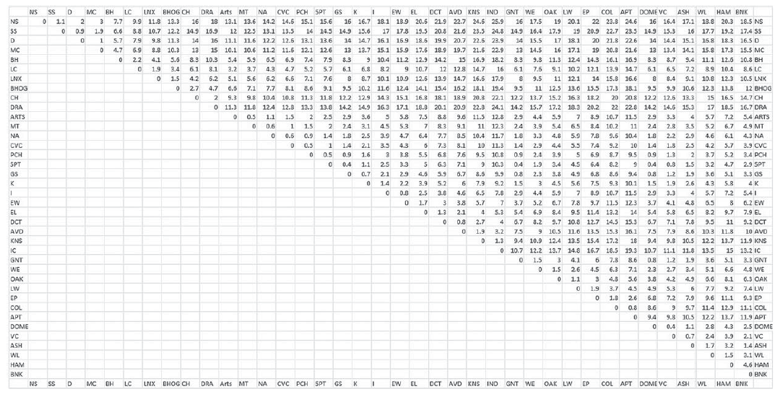
Rail distances (provided by MARTA)

Slide 48
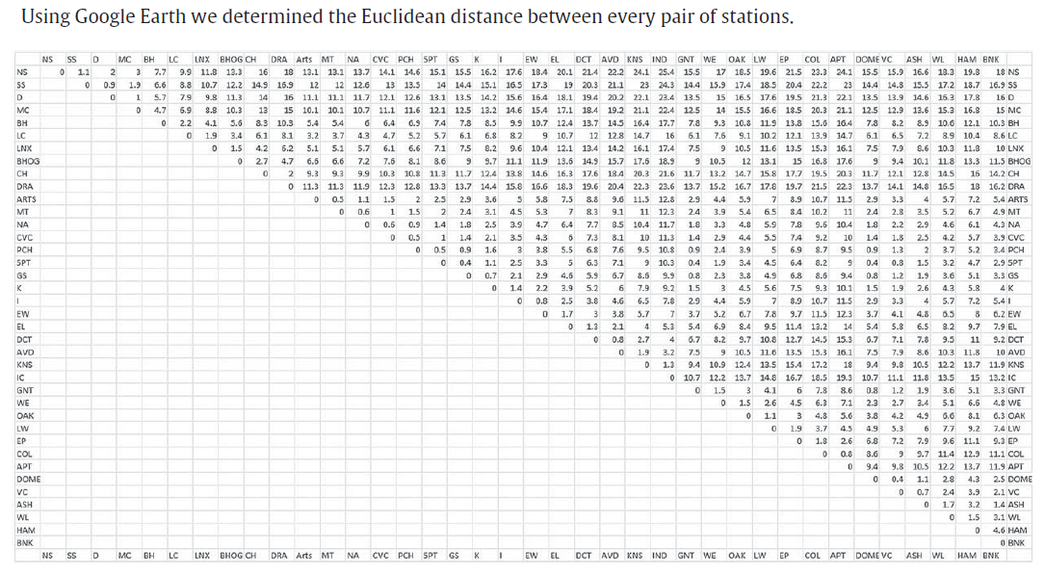

Slide 49
The MARTA network is 82% as efficient as a network where each pair of stations is connected by a direct line.

Slide 50
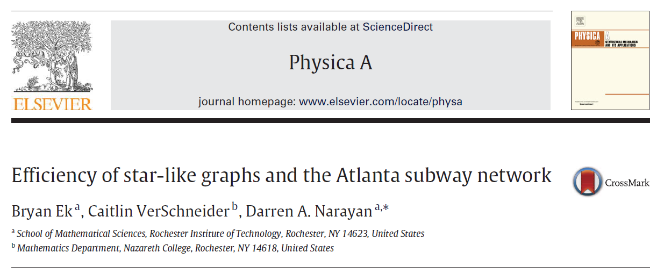

Slide 52
Thank you for your time!

